Slide 1
Game Sales and Data Visualization
7/13/2021
Andrew Wilson
Austen Hsiao

Slide 2
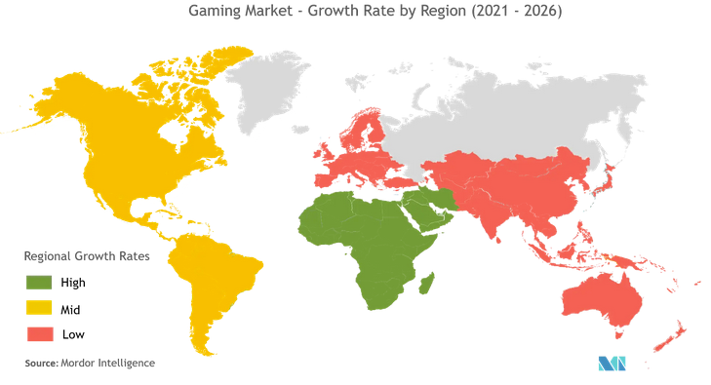
Introduction
Mordor Intelligence. Gaming Market - Growth, Trends, COVID-19 Impact, and Forecasts (2021 - 2026); 2021.

Slide 3
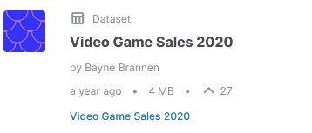
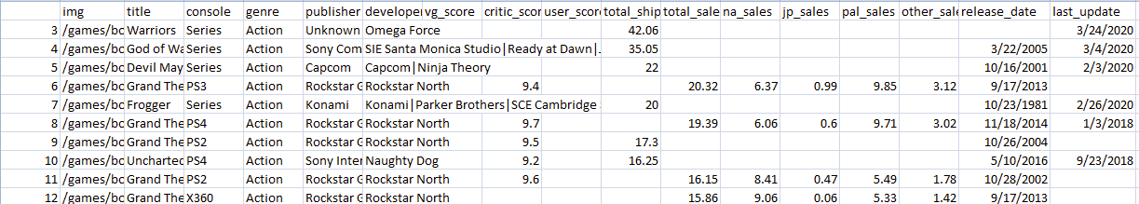
Finding Data
Publisher
Genre
Scores
Sales

Slide 4



Verifying Data

Slide 5

Data Cleaning

Slide 6
The World of Data Visualization

Slide 7
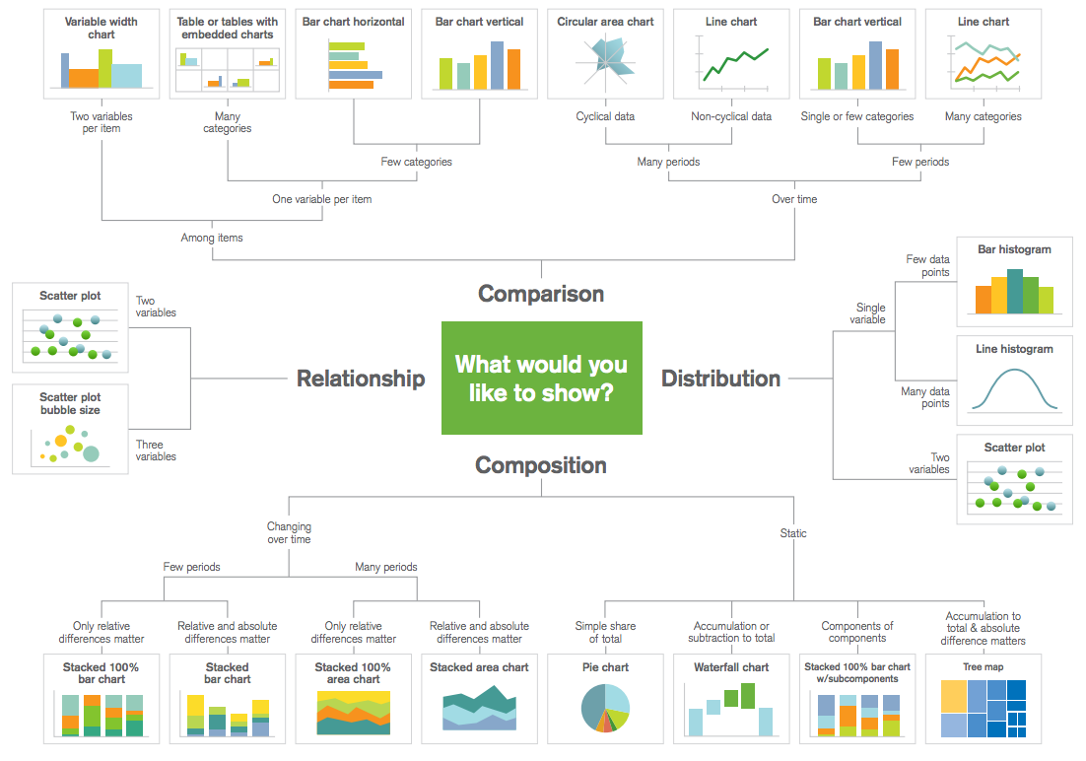
Choosing Your Weapon
<https://www.kdnuggets.com/2018/07/5-quick-easy-data-visualizations-python-code.html>

Slide 8



Data Visualization Options
Two Paths:
Python + Libraries
Matplotlib
Seaborn
plotly.py
Formal Business Intelligence software
Tableau
Microsoft Power BI
SAS Business Intelligence
Oracle BI

Slide 9
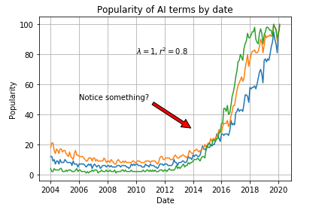
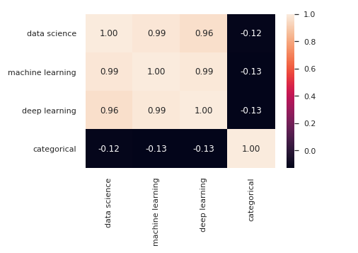
Python
Matplotlib line chart
Matplotlib
2D plots
Great starting point
Seaborn
Built atop matplotlib
Aimed at statistical representations
Plotly.py
Open source library from Plotly
3D charts, finance data, statistical charts
Seaborn heatmap
<https://towardsdatascience.com/complete-guide-to-data-visualization-with-python-2dd74df12b5e>

Slide 10






Business Intelligence
“Business intelligence (BI) leverages software and services to transform data into actionable insights that inform an organization’s strategic and tactical business decisions.”
- Mary K. Pratt and Josh Fruhlinger, CIO Group
Key Features:
Intuitive
Visualization
Predictive analytics
Reporting
Data mining
Event processing
Large datasets
BI

Slide 11
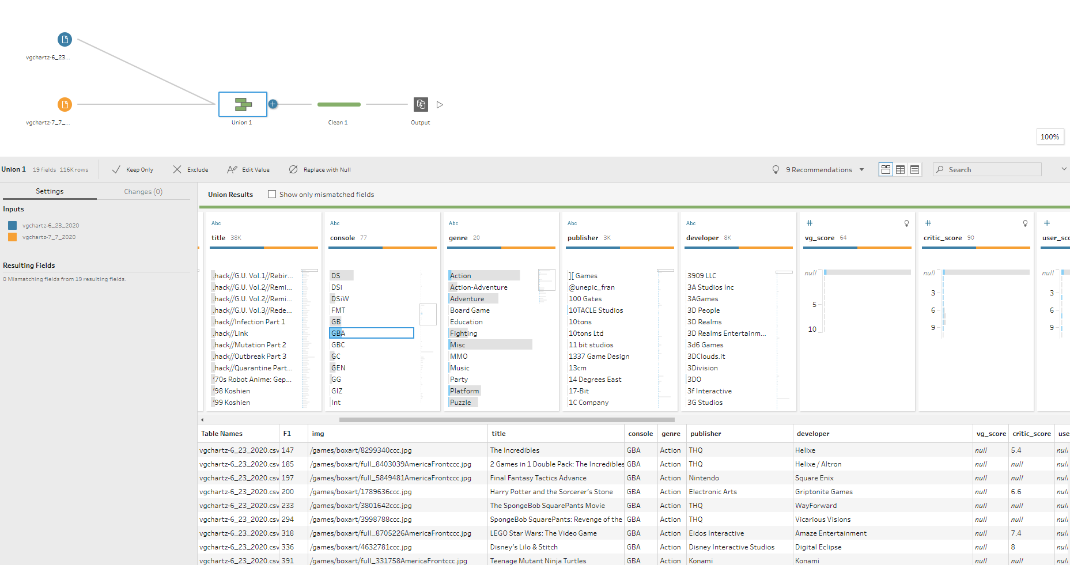
Tableau Prep
1
2
3

Slide 12
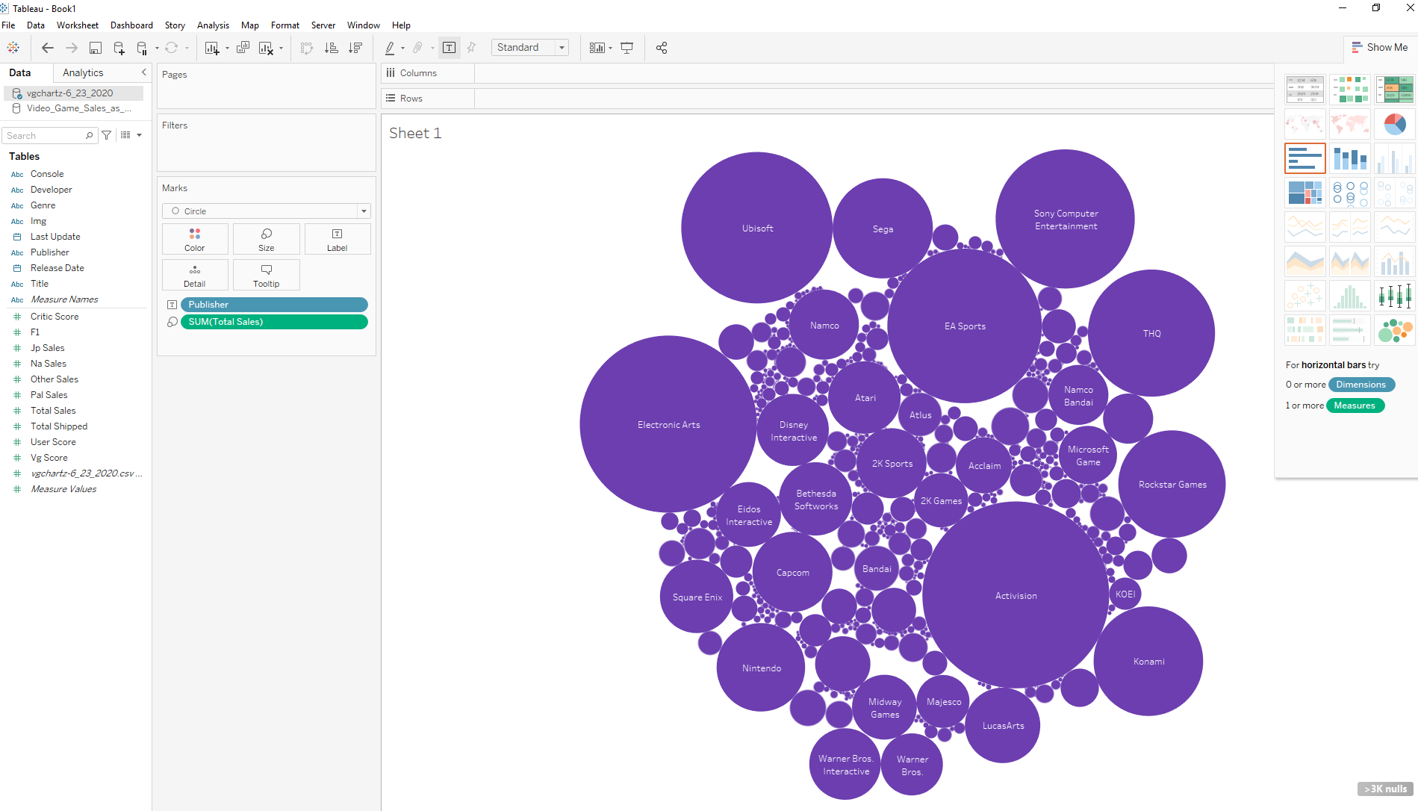
Tableau
2
3
1

Slide 13
Questions?

Slide 14
Sources
(1) Mordor Intelligence. Gaming Market - Growth, Trends, COVID-19 Impact, and Forecasts (2021 - 2026); 2021.
(2) Babb, J.; Terry, N. Comparing Video Game Sales by Gaming Platform. Southwest. Econ. Rev. 2013, 40 (1), 25–46.
(3) Cox, J. What Makes a Blockbuster Video Game? An Empirical Analysis of US Sales Data. Manag. Decis. Econ. 2014, 35 (3), 189–198. https://doi.org/10.1002/mde.2608.
(4) Pratt, M; Fruhlinger J. 2019. What is business intelligence? Turning data into business insights. (October 2019). Retrieved July 5, 2021 from https://www.cio.com/article/2439504/business-intelligence-definition-and-solutions.html
(5) Tanner, G. 2019. Introduction to Data Visualization in Python. Retrieved July 7, 2021, from https://towardsdatascience.com/introduction-to-data-visualization-in-python-89a54c97fbed

